Slide 1
BIOFERTILIZER
The sales pitch
September 2022

Slide 2
Main Selling Points - A Simple Story
REDUCE COSTS
Complementary, cost-effective solution to chemical fertilizer
IMPROVE FERTILIZATION EFFICIENCY
Powerful biostimulator for soil enrichment and better plant growth
DECREASE PESTICIDE AND FUNGICIDE USE
Strengthens crops and soil to resist pest and fungus contamination
INCREASE YIELD
Improves water and nutrient consumption efficiency for healthier, stronger plants
EASY INTEGRATION
Integrates easily into existing irrigation systems
ENHANCE FARMER RESILIENCE
Enables independent production of endless free biofertilizer to balance chemical fertilizer cost surge and shortage

Slide 3
Let’s look at the numbers - Fast ROI
1 HBG System
$115
BIOFERTILIZER
GAS
saved monthly
20% reduction in chemical fertilizer costs
Monthly chemical fertilizer cost: 500 USD
100 USD
saved monthly
PLG/charcoal replacement
Monthly expense: 20-25 USD
15 USD
saved monthly
$1380
Annual ROI
*Numbers represent a single system in Mexico
**Calculations are market-specific
*** ROI V Fertilizer calculations can be made through this link

Slide 4
Better ROI
GIVE THE BIOFERTILIZER A “MACRO PLANT” BOOST!
Create engagement with your client and generate future sales
Increase yield production
Ensure and increase savings on chemical fertilizer

Slide 5
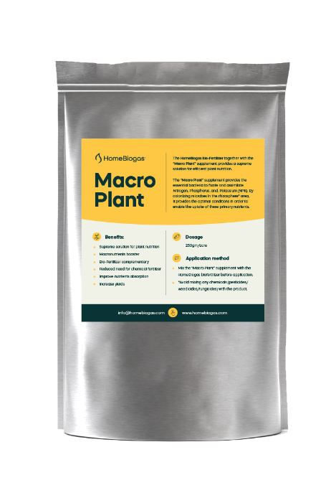
“Macro Plant”
HomeBiogas Biofertilizer together with “Macro plant” provide a supreme solution for efficient plant nutrition.
“Macro Plant” provides the essential bacteria to fixate and assimilate Nitrogen, Phosphorus and Potassium (NPK).
Colonizing microbes in the rhizosphere* area provide optimal conditions to enable uptake of these primary nutrients.
Benefits:
Supreme solution for plat nutrition
Macronutrients booster
Biofertilizer complementary
Reduce costs of chemical fertilizer
Improve nutrients absorption
Increase yields
*Area around a plant root that is inhabited by a unique population of microorganisms, where nutrients are uptake.

Slide 6
Q&A
Quantity
Nutritional characteristics
Concentration
(vs. chemical fertilizer)
Minimal application of biofertilizer: 1L/m2 (before dilution)
Characteristics stay constant if the system is ‘fed’ similar components. All Biofertilizers have all the micro & macro nutrients plants need – just in different concentrations.
One system produces tens of thousands of liters each year, so quantity compensates for concentration

