Slide 1

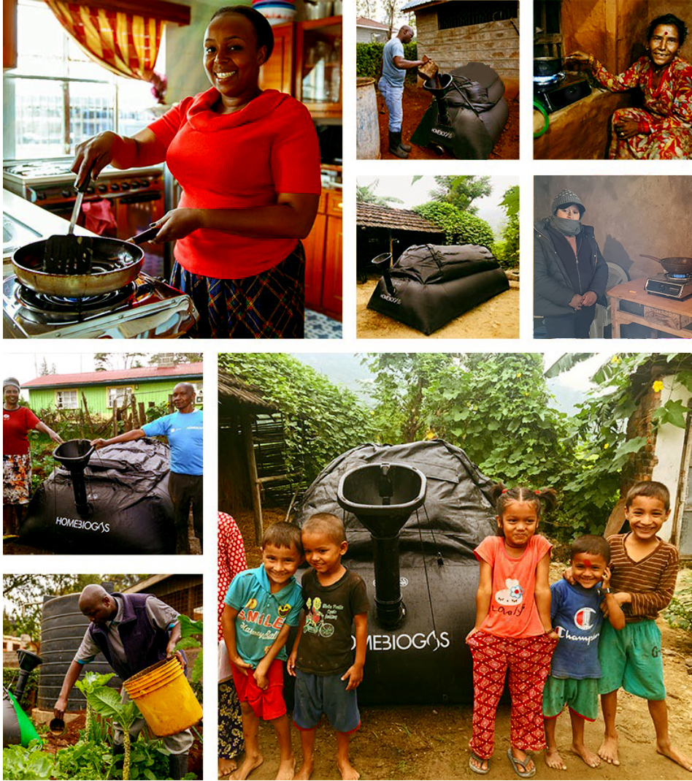

Training for Distributors:
How It Works

Slide 2


HOW IT WORKS
HomeBiogas Digestion Process
https://www.youtube.com/watch?v=8ESzZnfHNQo

Slide 3
BIOLOGY & CHEMISTRY

Slide 4
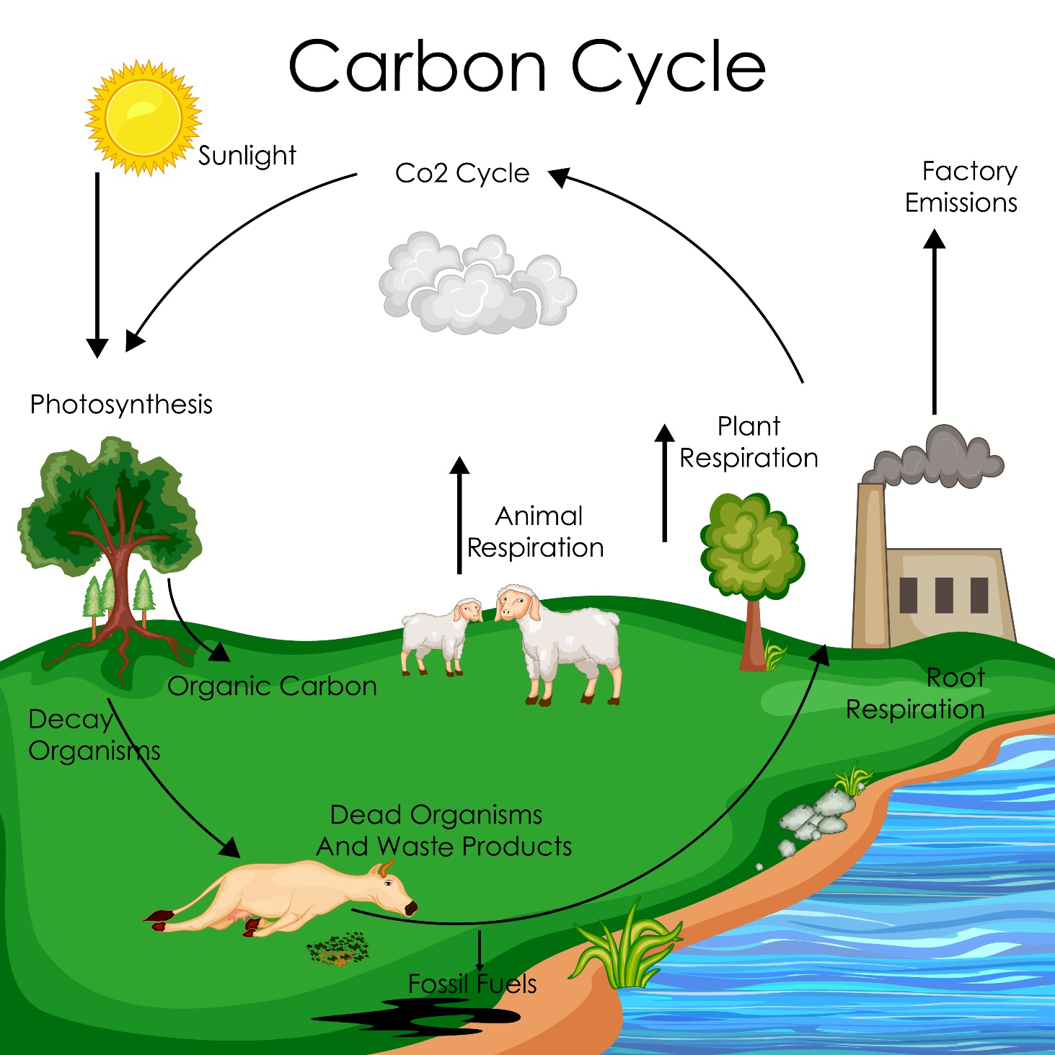
CARBON
CYCLE
Notes:
120+3 => 120 + 3
Surface ocean => Ocean surface
Microbail => Microbial
UN Goal→ Net Zero by 2050

Slide 5
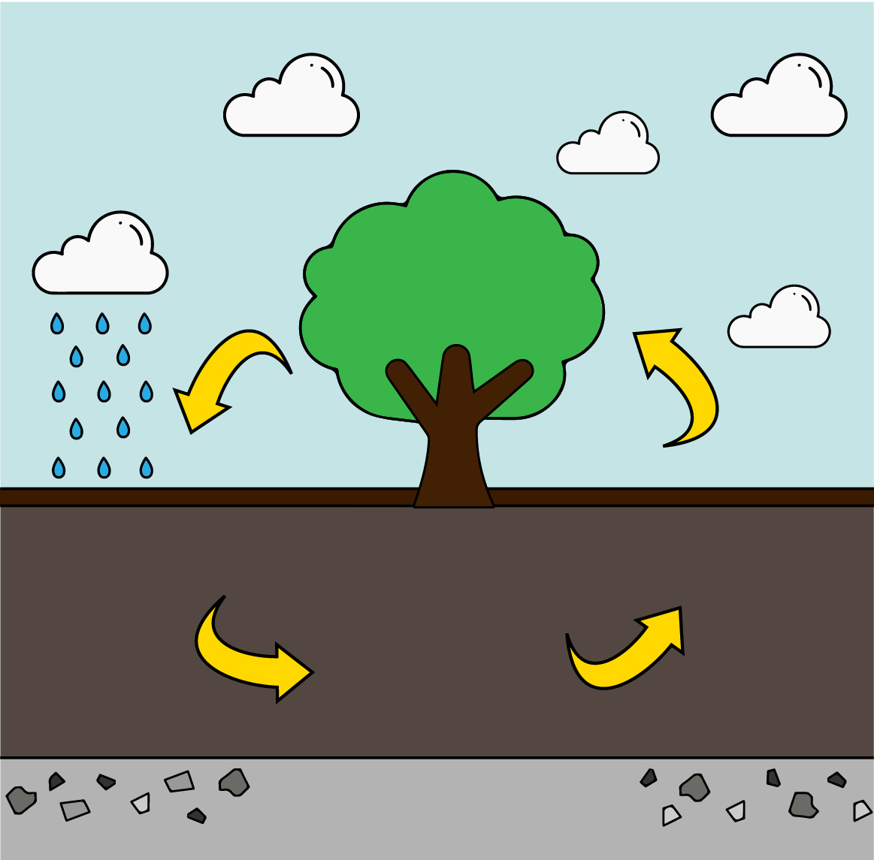
NUTRIENTS
CYCLE
Water and air
penetrate soil
Nutrients used to grow
Plant/animal matter breaks down into soil
Soil-stored nutrients which plants absorb
Decomposers break down organic matter
Rocky subsoil breaks down, providing nutrients in soil

Slide 6
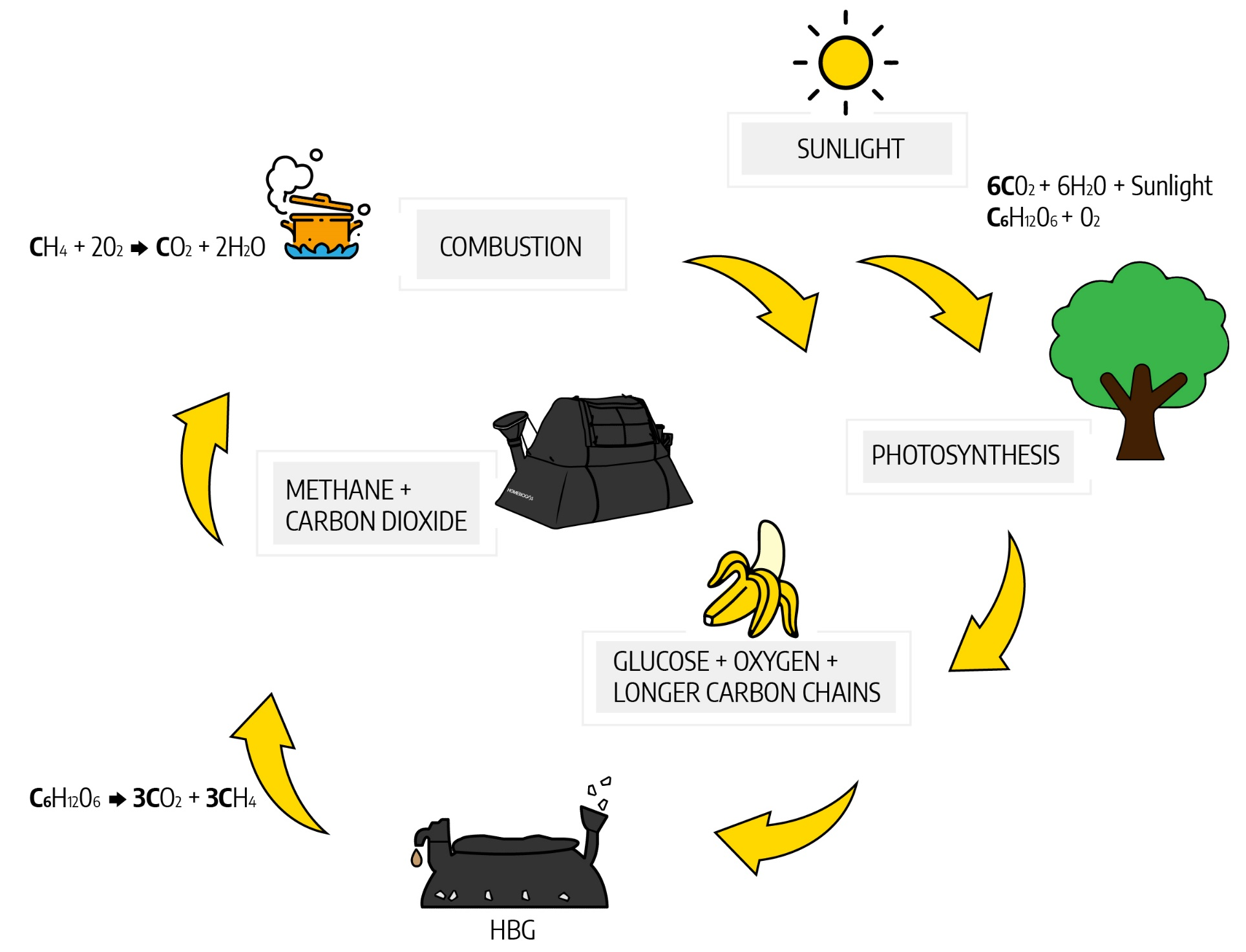
International Distributors Course May 2019
ENERGY
CYCLE

Slide 7
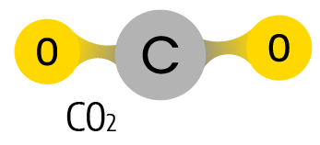
BIOGAS IN
THE CARBON CYCLE
Biogas typically refers to a mixture of different gases produced by the breakdown of organic matter in the absence of oxygen.
Typically, biogas consists of:
CH4
H2O
If we used the fossil fuels created in nature in the next 300–400 years, even those fuels would be carbon neutral
Biogas is carbon neutral as it completed the cycle of carbon replacement in a short time and does not deliver an excess load of carbon to nature

Slide 8
International Distributors Course May 2019
AEROBIC
DIGESTION
TYPES
C₆H₁₂O₆ + 6O₂ 6CO₂ + 6H₂O + 36 ATP
glucose
oxygen
carbon
dioxide
water
usable
energy
ANAEROBIC
C₆H₁₂O₆ 2 lactic acid + 2 ATP
glucose
usable
energy
34 ATP difference is analogous to the potential energy of the sugars that anaerobic digestion can break down and use to make biogas

Slide 9
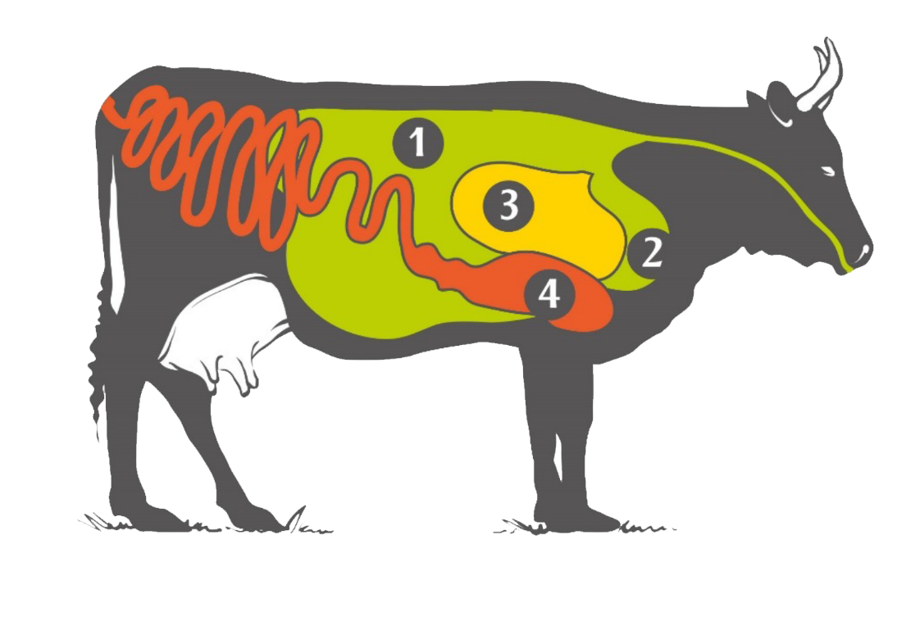
International Distributors Course May 2019
1 Hydrolysis
2 Acidogenesis
3 Acetogenesis
4 Methanogensis
ANAEROBIC DIGESTION
1 Rumen
2 Reticulum
3 Omasum
4 Abomasum
Notes:
Biopolymeres => biopolymers
Butyrate => butyrate

Slide 10
International Distributors Course May 2019
BIOGAS COMPOSITION
 | Formula | %
Methane | CH₄ | 50–75
Carbon dioxide | CO₂ | 25–50
Nitrogen | N₂ | 0–10
Hydrogen | H₂ | 0–1
Hydrogen sulfide | H₂S | 0–3
Oxygen | O₂ | Compound

Slide 11

International Distributors Course May 2019
GAS FILTER
H2S filtration
Made from Activated Carbon or Ferric Oxide
Why it is important to change the Gas Filter?
Avoids stove and metal bands corrosion
Removes unpleasant odor

Slide 12
PHYSICS

Slide 13
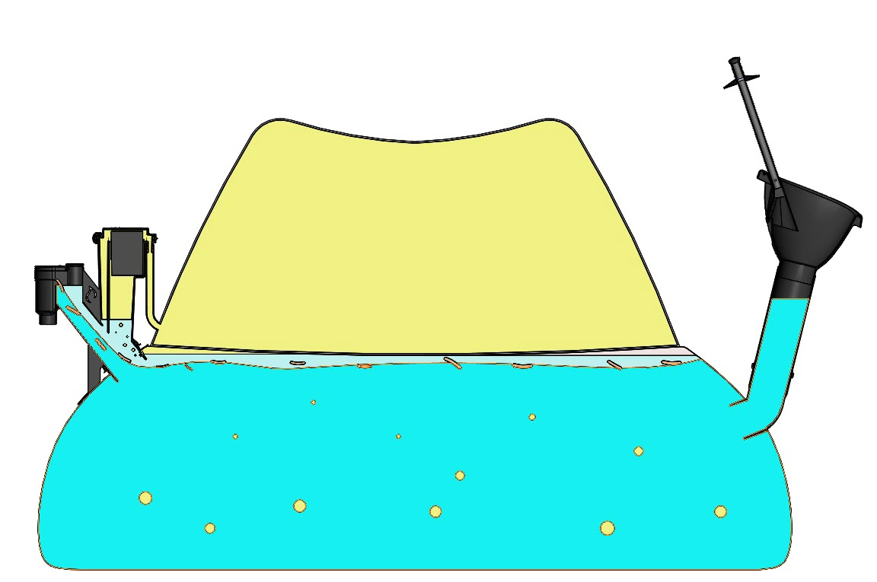
System equation gas pressure mechanism
1milibar = 1cm water column = 10.2 kg / m2
PROPERTIES

Slide 14
ENERGY- VALUE OF BIOGAS
PROPERTIES
1000 L of biogas at 60% methane = 5500 calories = 6.2 kWh = 22,000 MJ
1 kg cow manure = 35 L biogas
1 kg mixed food scraps = 100–200 L biogas
1 kg of LPG = 11,000 calories

Slide 15
FERTILIZER

Slide 16
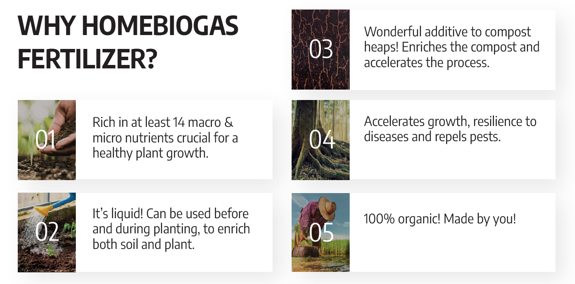
BIO FERTILIZER
High-quality organic liquid fertilizer produced as a by-product from
the digester tank
*** The first 30 days of fertilizer production, reuse it into the system. It is not fertilizer yet.
Notes:
a healthy plant growth => healthy plant growth
resilience to diseases => disease resilience

Slide 17
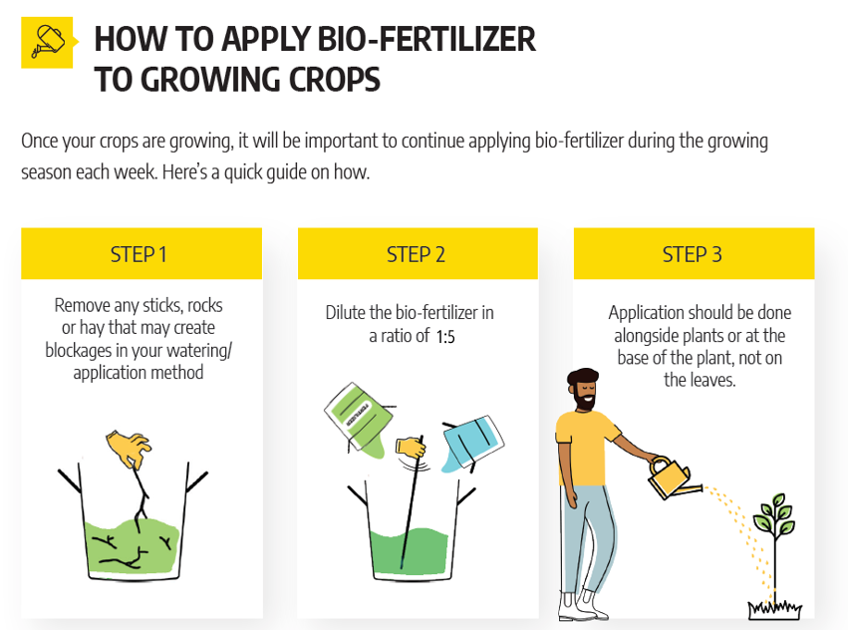
BIO FERTILIZER
Notes:
1-2 months => 1–2 months [USE EN-DASH AND HARD SPACE]
2-3 times per weeks apply => 1–2 times per week; apply [USE EN-DASH AND HARD SPACE]
to the plants roots. => to plant roots.

Slide 18

BIO FERTILIZER
http://www.biogassolutions.co.ug/downloads/Hivos-bioslurry-superior-fertilizer-book.pdf
Notes:
1-2 months => 1–2 months [USE EN-DASH AND HARD SPACE]
2-3 times per weeks apply => 1–2 times per week; apply [USE EN-DASH AND HARD SPACE]
to the plants roots. => to plant roots.

Slide 19
HEALTHY HBG

Slide 20
International Distributors Course May 2019
HEALTHY
SYSTEM
Feed according to instructions:
  Do not overfeed the system with food scraps
  Do not feed with food scraps if the average temperature is below 20°C/68°F
  Can cause the system to become acidic (low pH)
Best practice is to give a diverse range of feedstock—carbohydrates, vegetables, fats, proteins

Slide 21


PROPERTIES
HRT (Hydraulic Retention Time) = 30 days: the time any total feed “volume of slurry (hydrant)” is stored inside the digester
SRT (Solids Retention Time) = total time any total solids of a “substrate” are stored inside the digester
OLR (Organic Loading Rate) = total volatile solids added per 1000 liters of digester volume per day
Excess water causes flushing activity— chances of flushing out good bacteria with slurry
Feeding rate
  The amount of waste fed into the system/ daily
  HRT Calculation example:
  HBG 2.0 = 1450L system digester
  1450 L / 30 days = 48 L/day
  48 L/day = 1:2 ratio (manure:water) = 16 kg manure/day + 32 liters water/day
  16 kg /day * 35 L biogas = 560 L/ day

Slide 22
International Distributors Course May 2019
PARAMETERS
pH
  Should be between 6.2 and 7.8 for optimal performance
  Methane gas will stop produced under 6.2 , CO2 will continue to be produced.
    If pH goes below 5, no gas will be produced
Temperature
  Should be above 20°C and, for optimal performance, above 25°C (overheating is mostly not a problem)
  For every 10°C, the system kinetic of reaction doubles
Biogas is only flammable when methane content is above 45%

Slide 23
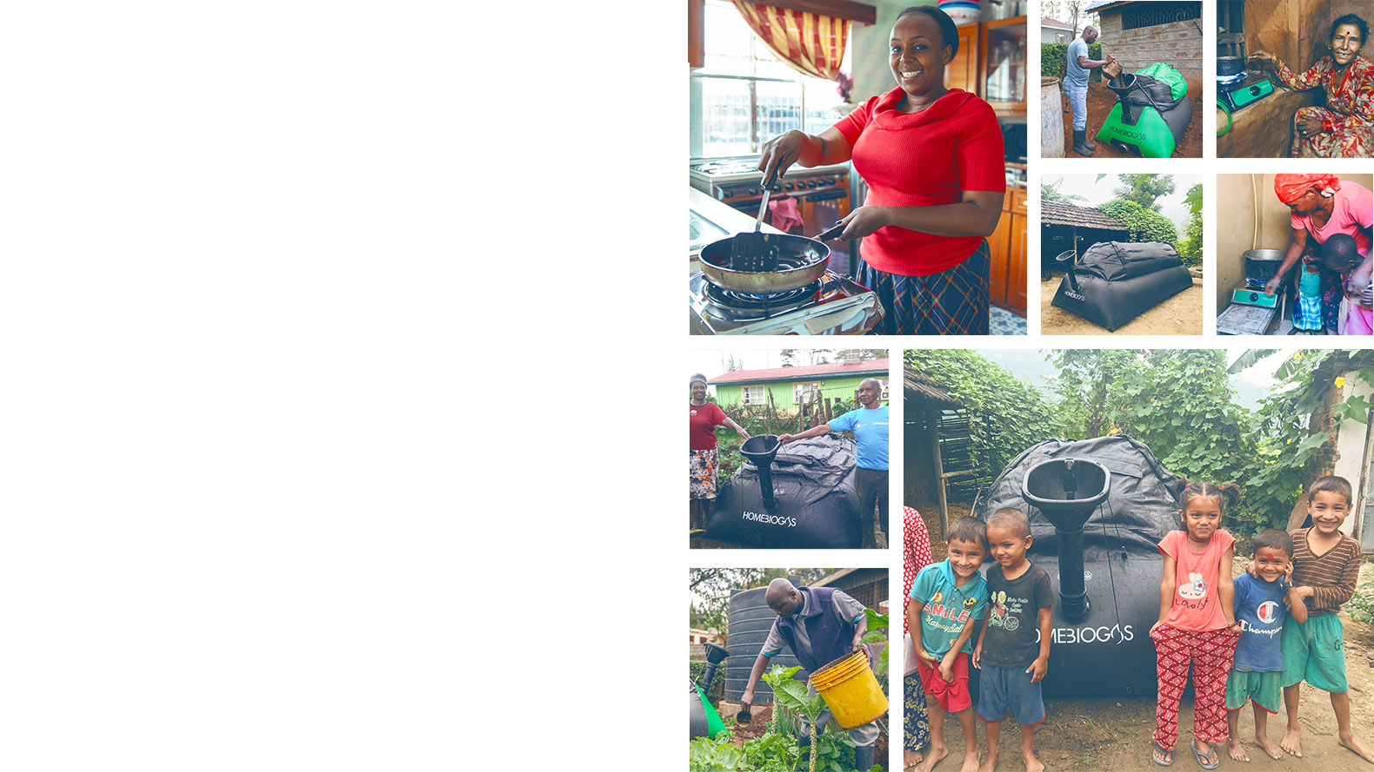
Thank You!
Any questions?

