Slide 1
BIO-FERTILIZER CONTENT DEVELOPMENT TOOLKIT

Slide 2
OVERVIEW
THE IMPORTANCE OF BIO-FERTILIZER CONTENT FOR MARKETING & SALES
WHAT WE KNOW ABOUT OUR FARMER TARGET AUDIENCE
TYPES OF CONTENT TO CONSIDER
STORY DEVELOPMENT
TYPES OF STORIES TO SEEK OUT
PRODUCTION GUIDANCE
TWO TYPES OF FORMATS TO FOLLOW & WHEN TO USE THEM
HOW TO MANAGE THE CAMERA IF YOU ARE DOING IT YOURSELF
SAMPLES
MATERIAL STORAGE
WHAT TO DO WITH THE CREATED MATERIALS

Slide 3
OVERVIEW

Slide 4
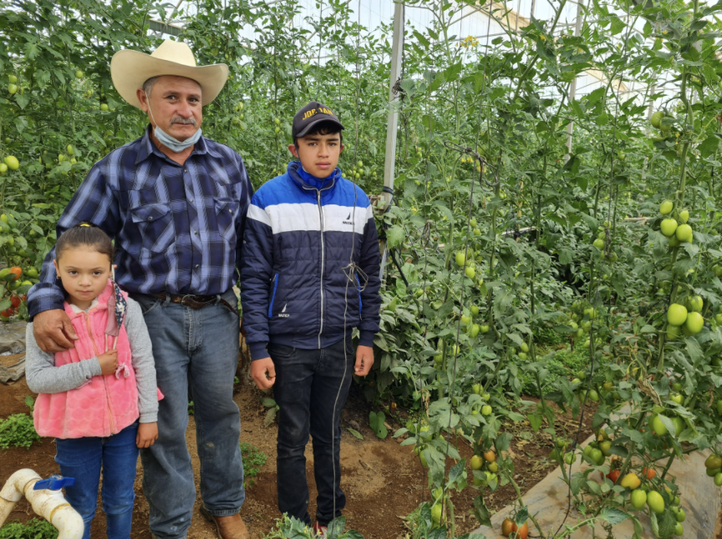
BROADEN YOUR PERSPECTIVE: THE IMPORTANCE OF BIO-FERTILIZER CONTENT FOR MARKETING & SALES
The fertilizer crises opened our mind and after research we found out that it could be main source of ROI in many countries. Though cooking gas is still an important selling point, we realized that we had an amazing product with us all along: The Biofertilizer.
That’s why we believe its important to promote and develop marketing materials about successful case studies of farmers using the biofertilizer, because by communicating their stories, other costumers could relate with having economic savings through spending less on chemical fertilizer or increasing income from higher crop yield, promoting additional sales and gaining confidence using the system.

Slide 5
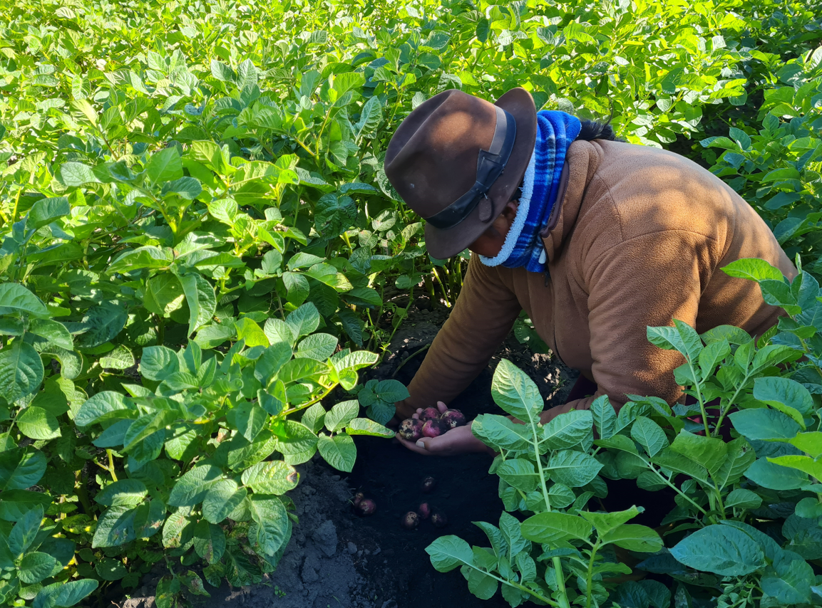
WHAT WE KNOW ABOUT OUR FARMER TARGET AUDIENCE
1. The main motivator to them is ROI (cost savings or additional profits)
2. Seeing is believing and they need to see/hear examples of people in their own country benefiting if they are to adopt it (visiting in person or watching a video is also great)
3. A/B test proof is probably the strongest way to demonstrate results
4. Social media can work in some markets but the best way of approaching potential customers is face-to-face

Slide 6
HOW TO START
1. The importance of preparing a good “White paper” for the case studies — we developed a list of questions to collect information about the farmer, the size of the farm, the crops, the results of fertilizer application, the feedback on the system, the savings, etc. This is very important comparative and informative database for us to develop success stories. A good white paper is the gate for our selling success! (THIS DOCUMENT IS ATTACHED ON THE E-MAIL)
2. Photo and video content — we need the raw files so we can work on the creation of marketing materials. Of course it is ok for you, as a distributor, to develop your own material, we encourage that and will give on this presentation some tools on how to do it right. But we do need the files without editing to produce other materials.
*After you give us this, we can provide marketing/promotional materials such as videos, selling flyers, Facebook/Instagram posts, press releases, brochures, etc

Slide 7
STORY DEVELOPMENT

Slide 8
TYPES OF STORIES TO SEEK OUT
Farmers talking about how much they save on fertilizer now that they use HomeBiogas bio-fertilizer
2. Farmers talking about how much more crop yield they have been able to produce, and the amount of additional money associated because of this
3. Stories about how farmers, who have been profiting from using bio-fertilizer for some time, have used their excess income to start new business endeavors or buy something to benefit their farm.
4. Examples of how farmers have set up tests where they have a control plot, only using water, compared to plots using chemical fertilizer and bio-fertilizer, showing the positive results bio-fertilizer can have
5. Stories from farmers on how bio-fertilizer has improved their overall soil health and condition over time and what this means for future crop production
*Check our videos in our YouTube channel!
Homebiogas official - https://www.youtube.com/c/HomeBiogas1
Homebiogas customer success - https://www.youtube.com/channel/UCiNr6FzQ-Kb4wNsLGBWXH5w

Slide 9
PRODUCTION GUIDANCE

Slide 10
TWO TYPES OF FORMATS TO FOLLOW & WHEN TO USE THEM
1. Testimonial videos
2. World Economic Forum style video
*Always make a short 1:00 - 1:30 min video told through the voice of a farmer explaining their ROI story involving bio-fertilizer
*Content to be formulated based on white paper interview with farmer
*Ideal footage to show would be of the farmer doing his everyday tasks around maintaining the Homebiogas system, the preparation and application of the bio-fertilizer, shots of thriving crops, harvesting crops where possible, selling the crops at markets, scenes with their happy families cooking and sharing meals using biogas
*BEFORE MAKING THE SHOOTING, PLEASE CHECK THE ATTACHED DOCUMENT WITH THE 10 BEST PRACTICES FOR MAKING VIDEO TESTIMONIALS

Slide 11
TESTIMONIAL VIDEOS
A video that uses the voice of the farmer through an interview based on a series of questions from the initial white paper survey. It will use clips from around the farmer’s farm, shows them interacting with the system, using the fertilizer and showing results. It’s great to use this style of video because it’s more believable to potential customers. You should use this style of video if the farmer is comfortable talking to camera, if not it’s best to go with a video that requires less involvement from the farmer
Little footage of the farmer talking directly to camera (no more than 10%, recommendation would be to use their voices more, while showing actions to keep things more interest)
Watch an example from Mexico!
https://www.youtube.com/watch?v=ceg4UtvLda4

Slide 12
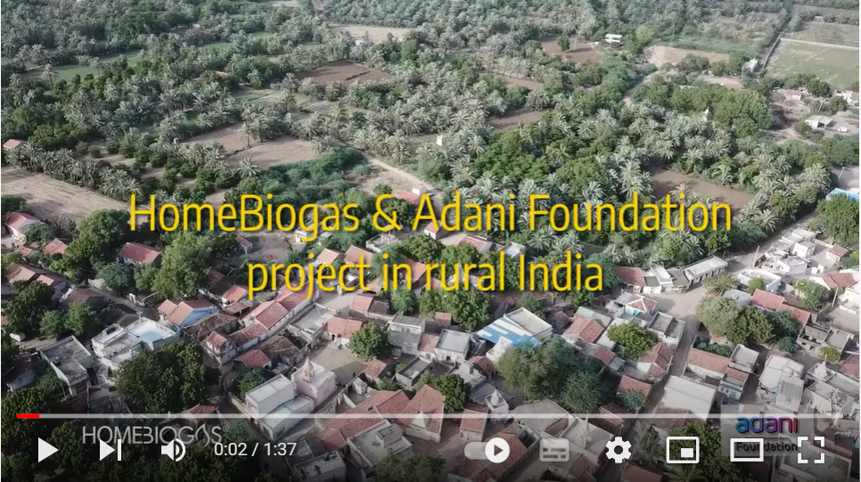
WORLD ECONOMIC FORUM VIDEO STYLE
A video that uses clips from around the farmer’s farm, shows them interacting with the system, using the fertilizer and showing results. Instead of using the voice of a farmer, titles on screen and images of the farmer doing his/her daily tasks will narrate the story and ROI vs the farmer.
This style is easier to work with as you can tell the exact story you want based on the white paper, it’s just not as personal. But production effort can be less costly with this version
Work on showing key elements that are highlighted in the white paper
Watch an example from India!
https://www.youtube.com/watch?v=p98RaPOs2jk&t=5s

Slide 13
PRODUCTION GUIDANCE
Important to have proper camera, tripod and audio equipment (mic pack or boom mic)
Make sure you have a release form signed for each person featured in the video (ATTACHED IN THE EMAIL)
Get some nice still shots that can be used for social media
Be sure to choose a place without background noise or lots of wind
When asking questions, be sure to make sure they answer in a complete sentence (e.g., My name is xxx and I live xxx)
Tidy up the compound, around the system and the kitchen prior to the shoot
Ask them to not use the system for one day and if necessary, pay them for the gas they would use in a day or provide them with gas for cooking during that time
Bring some nice supplies (food, new towels or tools/clean pots for their kitchen that can be set up to look good)
If you know the types of crops they’re growing, buy back up of these for the kitchen or/and to show them being brought in front of the field/system
TAKE MULTIPLE SHOTS WITH VARIATIONS (both wide and closer in) around the compound

Slide 14
HOW TO MANAGE THE CAMERA IF YOU ARE DOING IT YOURSELF
Holding It Right: Even though phone cameras have image stabilization, it’s generally not enough if your grip is shaky
Hold the phone in both hands and hold your arms with your elbows pointing towards your feet
For more stability, lean your elbows against your stomach
If your phone has a physical camera trigger, use it. That will make the process more convenient and reduce the risk that you’ll blur your photos
Think About Composition: don’t forget that neither the horizon nor your subject should be centered. Put the horizon in the photo’s lower, or occasionally upper third, and put the subject towards an edge. Ideally on a golden ratio point.
Don’t make sudden transitions, try to make them smooth! For this purpose, is better to make more shots instead of turning the camera to different positions several times

Slide 15
SAMPLE SHOTS
Shot around the compound — the home, family, kitchen, animals and system
Shot of animal manure being collected, mixed (1:3) and fed into the system with a clean environment around the animals and a clean and full system
Close-in/wider angle shots of bio-fertilizer coming out of system
Bio-fertilizer application method, showing the farmer applying to crops
Shots of each crop mentioned — both wide angle shots and cropped close in panning over the crops to see the veg, grains or fruits
Take nice panning shots of the system, be sure to capture the logo
Shots of the family and kids around by the system/playing near the system
Shots of harvesting an abundance of crops as a result of the bio-fertilizer - baskets being carried from the fields, shots with them with crops standing by their system, maybe a shot of vegetables piled up in the kitchen
If a farmer is selling crops locally, see if a shot can be taken of them bringing/selling them to market (meaning making extra income)
Shots of family looking happy, standing up and cooking on biogas (someone lighting up HBG stove close and from a short distance so you can see the logo; shots of families eating together)
If they are saving money from not using firewood/charcoal/gas, then be sure to capture some images of before Biogas (cooking over a smoky fire; blackened kitchen and ashes from fire on the floor; people trying to light up their fires, blowing in the fire, coughing etc)
Drone establishing shots of area, compound and system (depending on availability and budget)

Slide 16
MATERIAL

Slide 17
WHAT TO DO WITH THE CREATED MATERIALS
Send everything you gathered about a study case
to us on WhatsApp and/or E-mail!
Ronit Segal – ronit@homebiogas.com – +972 52 4768942 Pablo Chevrin – pablo@homebiogas.com – +972 52 8377466 Dana Avitan – dana@homebiogas.com – +972
Material list:
Filled white paper
Raw images and videos
Release form

Slide 18
THANKS!

