Slide 1

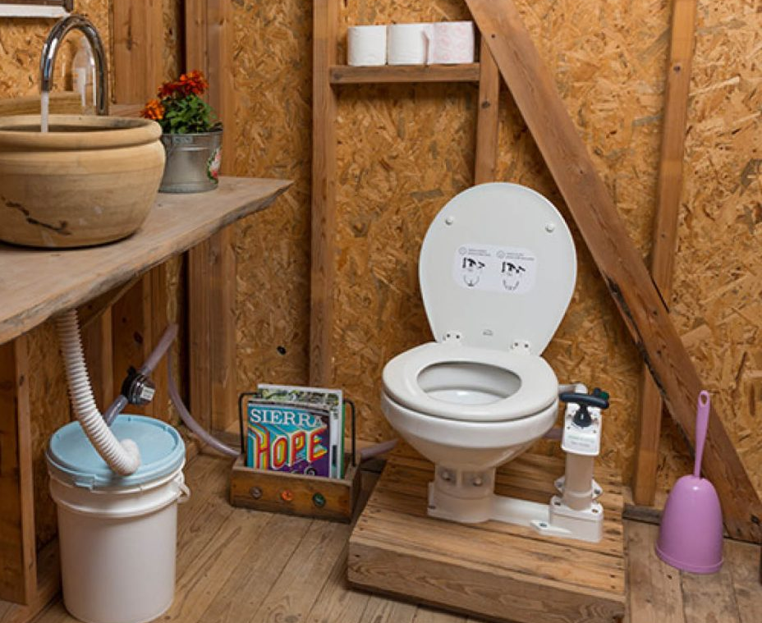
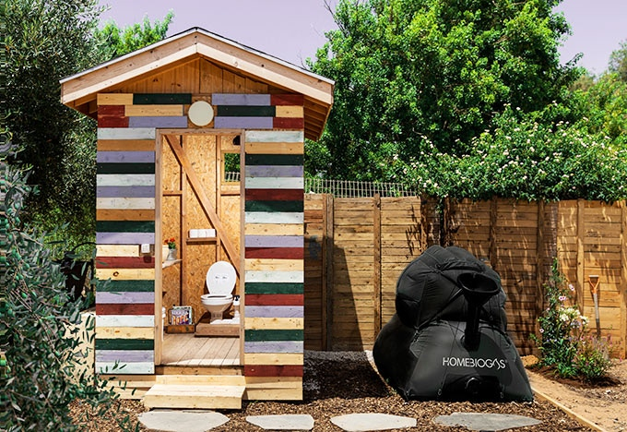

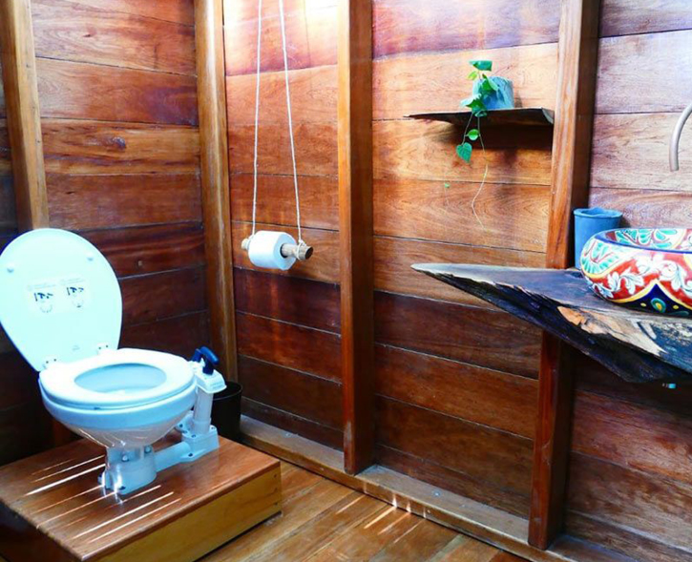
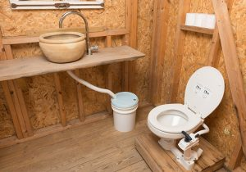
Training for
distributors
Bio-Toilet

Slide 2
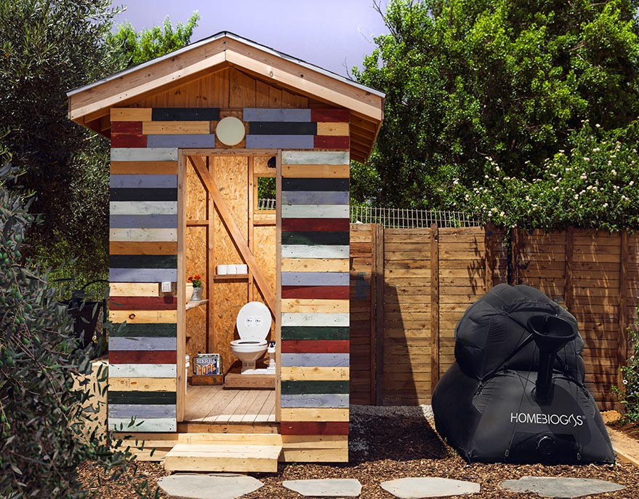

BIO-TOILET
CONNECTED TO HOMEBIOGAS
SYSTEM
© HomeBiogas Ltd. 2021. All rights reserved

Slide 3
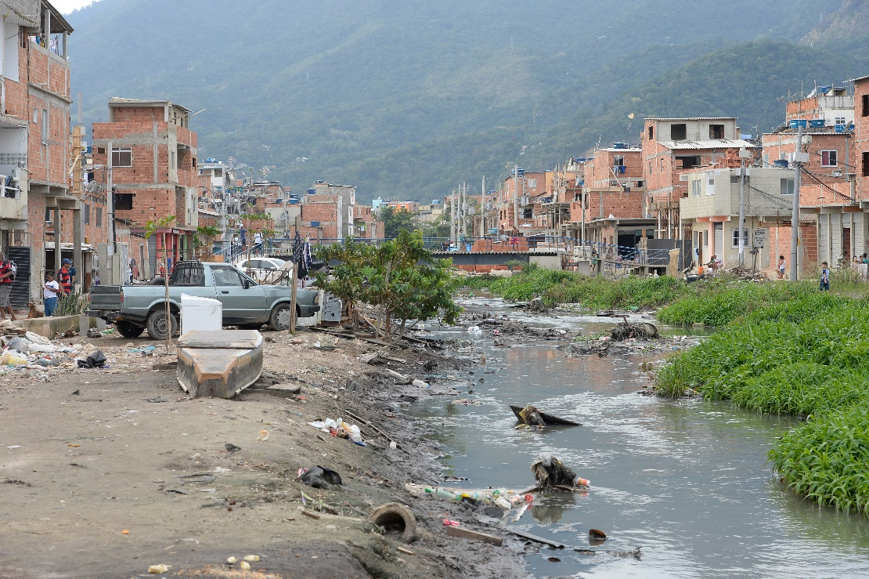
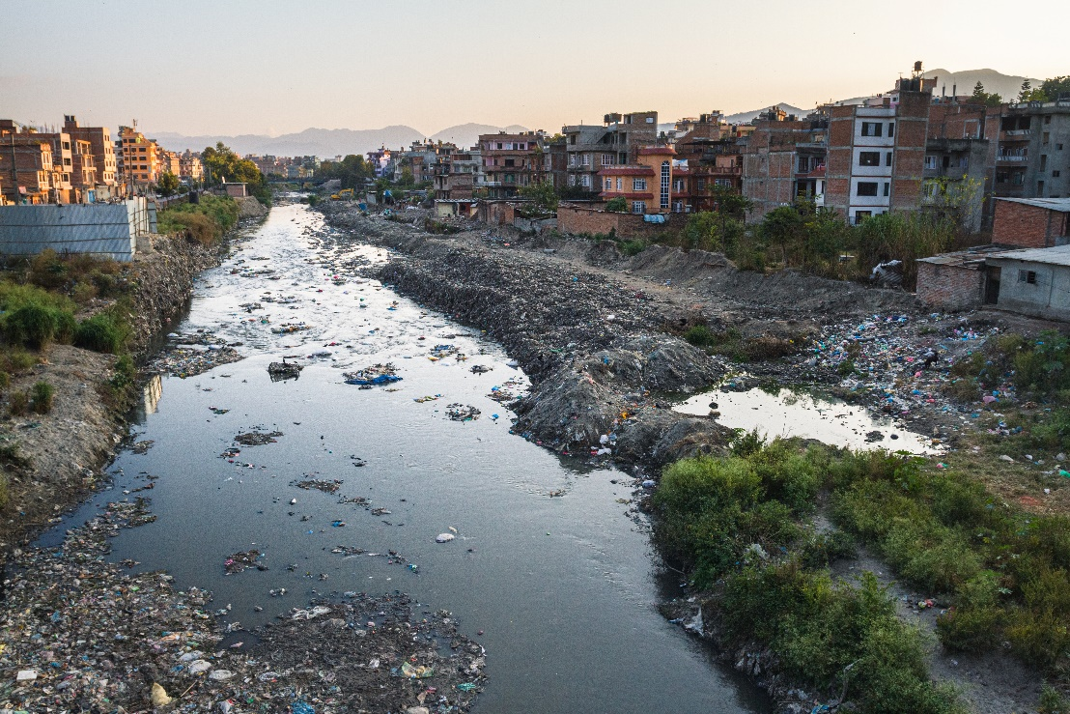
SANITATION
GLOBALLY
GLOBAL
SITUATION
According to the United Nations, about 2.6 billion people do not have access to sanitary toilet and sewage facilities.
1 billion people still practice “open defecation” or going in the bush near villages.
This leads to water supply contamination and spread of disease.
© HomeBiogas Ltd. 2021. All rights reserved

Slide 4
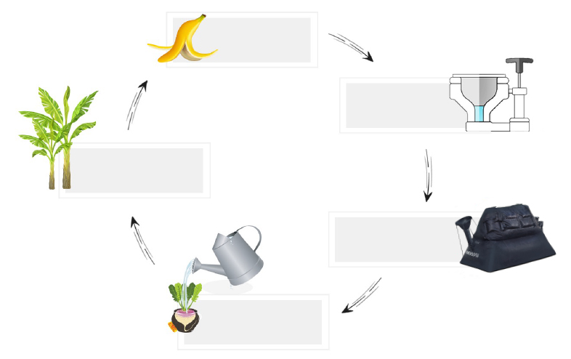
BIO-TOILET
CYCLE
PLANTS ARE EATEN
EXCRETION
The HomeBiogas Bio-Toilet offers an off-grid, dignified sanitation solution to manage human waste by sending waste from the toilet directly to the HomeBiogas biodigester.
PLANTS USE NUTRIENT TO GROW
HBG BREAKS DOWN WASTE
FERTILIZER RETURNS NUTRIENTS TO SOIL
© HomeBiogas Ltd. 2021. All rights reserved

Slide 5

BIO-TOILET
FEATURES
TECHNICAL SPECIFICATIONS
INPUT
OUTPUT
*30 flushes per day:
Each flush 1.2 liters / 0.3 gallons
Nominal daily biogas:
300 L (using toilet waste only)
Effluent produced: up to 30 L
© HomeBiogas Ltd. 2021. All rights reserved

Slide 6

MAIN CHARACTERISTICS
HRT: 30 days
Treatment – prevents human contact
BIO-TOILET
FEATURES
BIO-TOILET AND SYSTEM DISTANCE
EFFLUENT TREATMENT
HRT
30 days
VOLUME AND DIMENSIONS
HRT = Hydraulic Retention Time
Dimensions of box for shipping: 51W/53L/43H (cm) / 20W/21L/17H (in)
Maximum distance between the Bio-toilet and the system:
10 meters
Connection to:
Sewer
Mulch Basin
Drain-field
© HomeBiogas Ltd. 2021. All rights reserved

Slide 7


BIO-TOILET
BENEFITS
UNIQUE FEATURES
WATER SAVING
Uses up to 1.2 liters / 0.3 gallons of water per flush
SIMPLE INSTALLATION
No digging or infrastructure
required
OFF-GRID
No need
to connect the toilet
to the water or
sewer grid
EFFICIENT DESIGN
Easy to transport
(comes in a small box) and store many
systems
Economic savings through having an off-grid self-managing waste.
Improve sanitation and reduce environmental contamination by ensuring waste is safely treated.
Hygiene and human dignity are preserved with an easy-to-implement solution.
© HomeBiogas Ltd. 2021. All rights reserved

Slide 8

BIO-TOILET
INSTALLATION VIDEO
https://www.youtube.com/watch?v=ZmVNKXziXiw
© HomeBiogas Ltd. 2021. All rights reserved

Slide 9

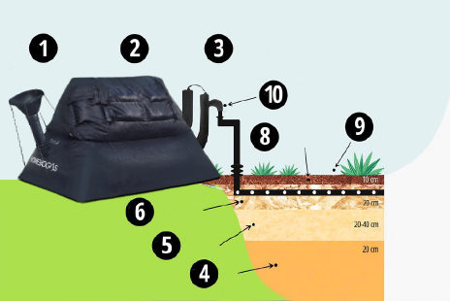
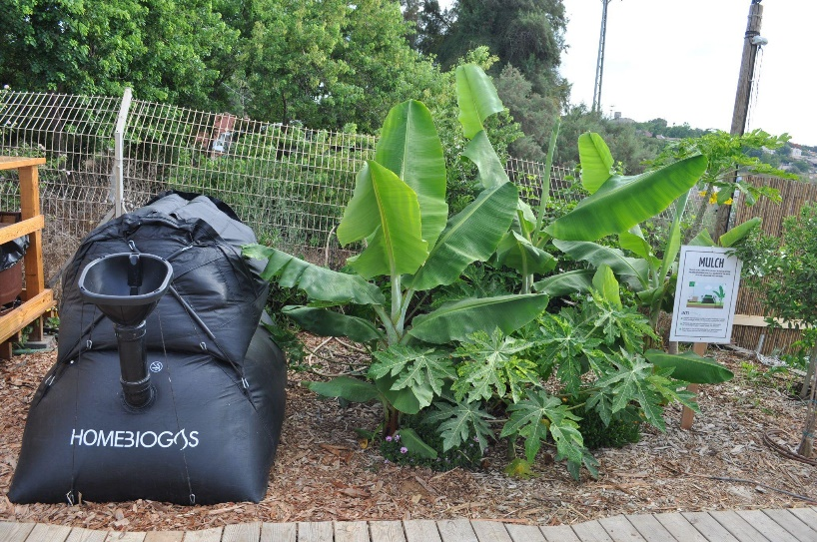
EFFLUENT
TREATMENT
MULCH BASIN
HomeBiogas Facilities
PICK A
LOCATION
DIG A
DITCH
PREPARE PVC PIPE
CONNECT TO THE
HOMEBIOGAS
LANDSCAPING
MULCH
ROUGH WOOD CHIPS: LAYER 2
ROUGH WOOD CHIPS: LAYER 1
FINE WOOD
SHREDS
SOIL
© HomeBiogas Ltd. 2021. All rights reserved

Slide 10
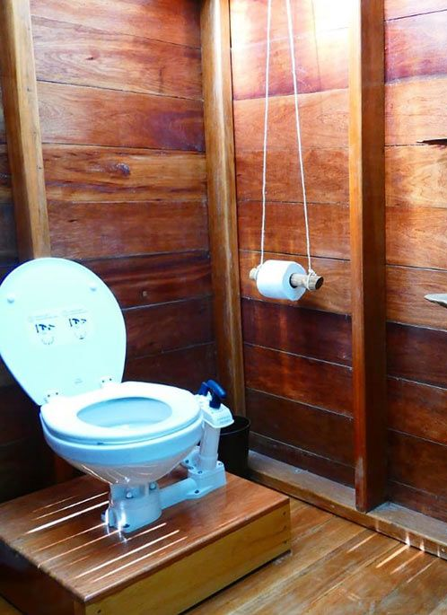


TESTEMONIAL
ADAMA
OFF-GRID SUSTAINABLE COMMUNITY
Located in the North of Israel
Moved from compost toilets to the Bio-Toilet:
  Less physical maintenance
  No smell
  Gas and fertilizer production
  Quality of life
Quoting Reut:
“The Bio-Toilet allows us to still live close to nature,
but elegantly and cleanly.”
© HomeBiogas Ltd. 2021. All rights reserved

Slide 11
Thank you!
Any Questions?

